Slide 1
INdex
Machine Learning and types – Introduction
Classification VS Regression
Types of Regression
Linear Regression – Simple and Multiple
Logistic Regression
Linear VS Logistic
Summary

Slide 2
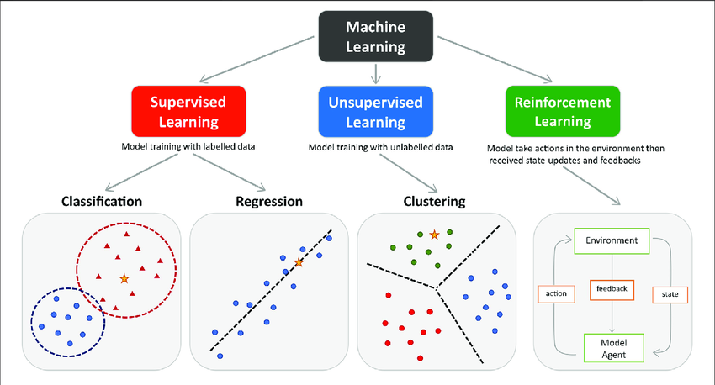
Machine learning - INtroduction
Machine learning - branch of artificial intelligence (AI) and computer science that focuses on the using data and algorithms to enable AI to imitate the way that humans learn, gradually improving its accuracy.
- IBM
Categories of Machine Learning
Supervised learning
Unsupervised learning
Reinforcement learning

Slide 3
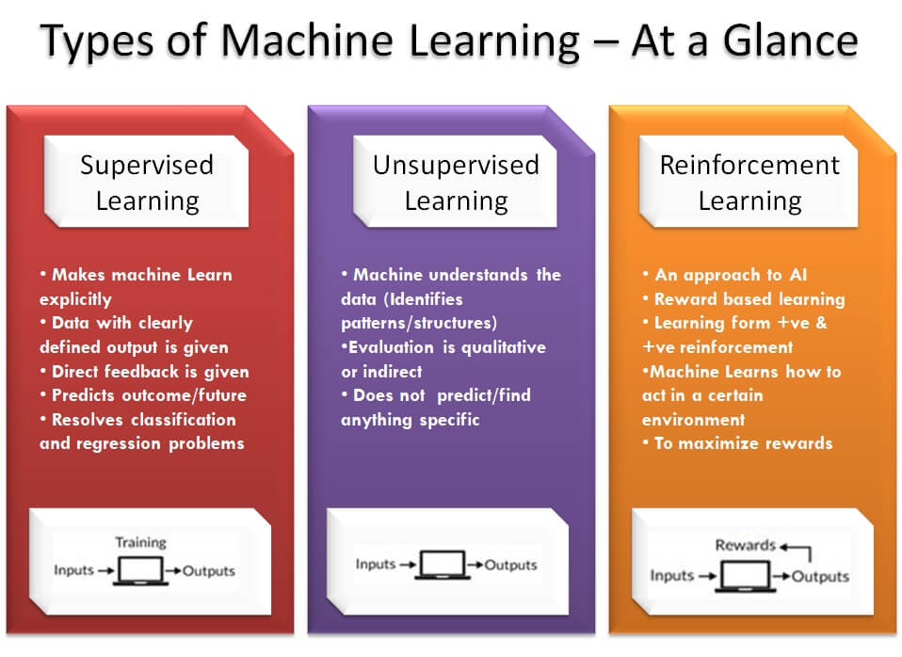
Types of Machine learning

Slide 4
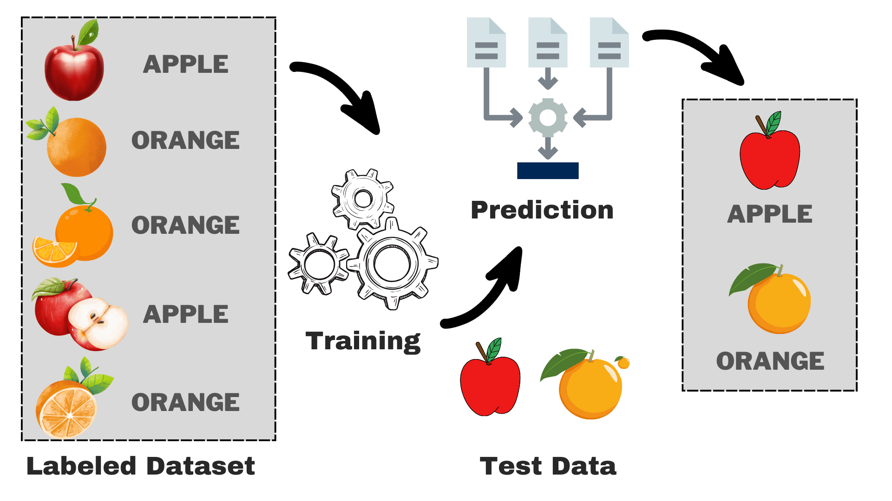
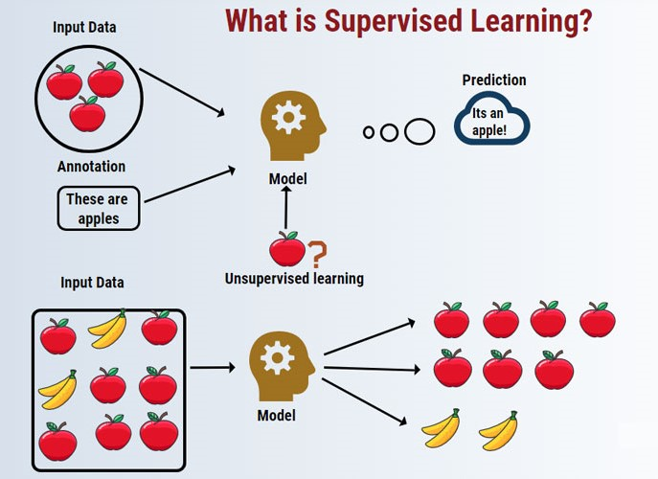
supervised learning
Supervised Learning - category of machine learning that uses labelled datasets to train algorithms to predict outcomes and recognize patterns.

Slide 5
Classification vs regression (supervised learning)
Classification - a supervised machine learning method where the model tries to predict the correct label of a given input data.
In classification, the model is fully trained using the training data, and then it is evaluated on test data before being used to perform prediction on new unseen data.
Regression - a supervised machine learning technique which is used to predict continuous values.
The ultimate goal of the regression algorithm is to plot a best-fit line or a curve between the data.
The three main metrics that are used for evaluating the trained regression model are variance, bias and error.

Slide 6
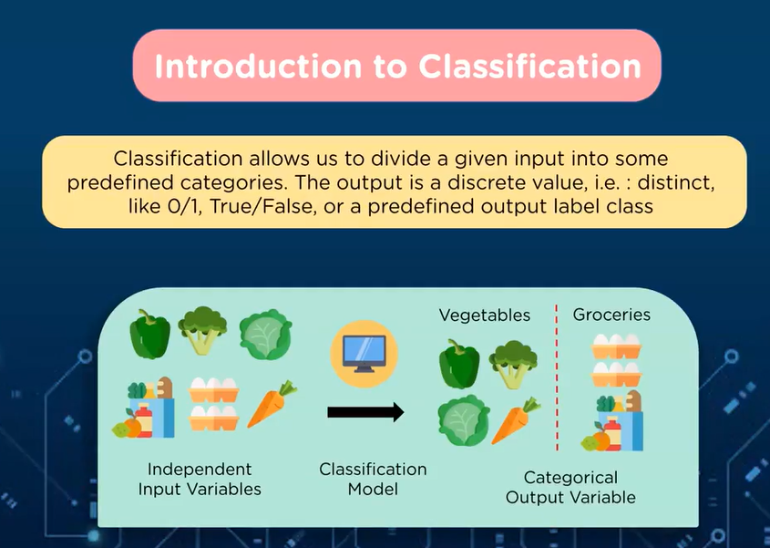
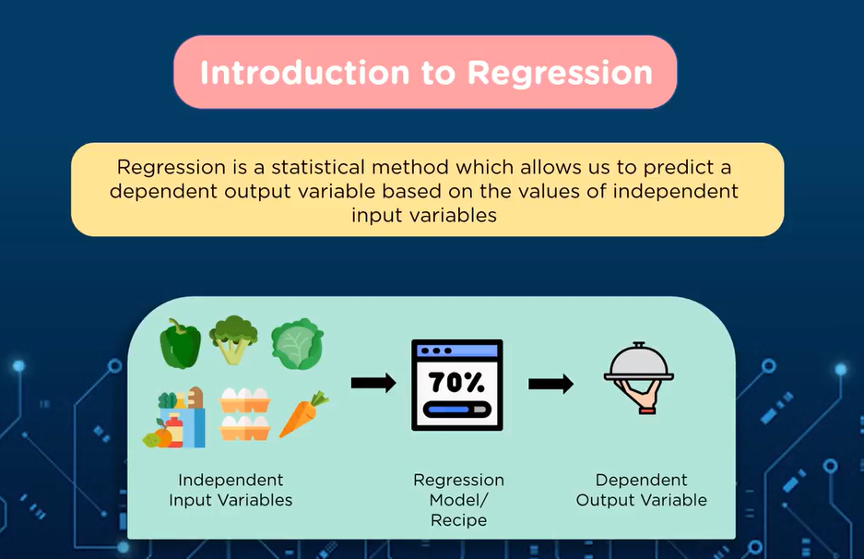
Classification vs regression

Slide 7
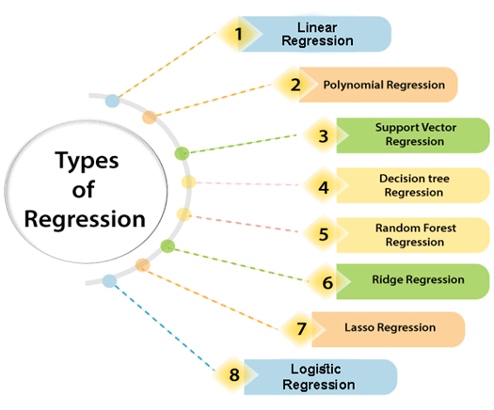
types of regression

Slide 8
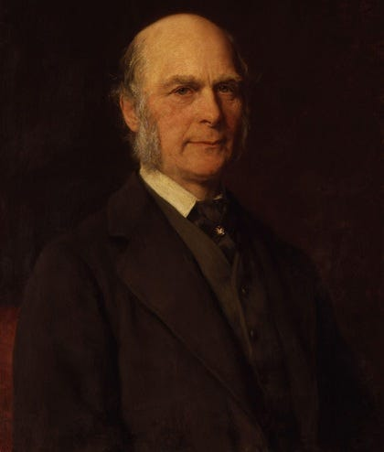

Linear regression - history
Sir Francis Galton (1885) introduced the idea of “regression” to the research community in a study examining the relationship of fathers' and sons' heights.
In his study he observed that sons do not tend toward their fathers' heights but instead “regress to” the mean of the population.

Slide 9
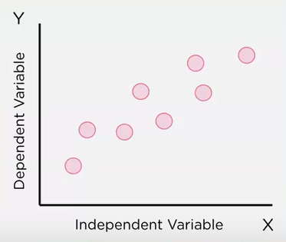
Linear regression - discussion
Linear regression – machine learning model that is used to predict the values of output variables based on the value of input variables.
It predicts the relationship between two variables by assuming they have a straight-line connection.
It finds the best line that minimizes the differences between predicted and actual values.
Linear regression is a quiet and the simplest statistical regression technique used for predictive analysis in machine learning.
Linear regression shows the linear relationship between the independent(predictor) variable i.e. X-axis and the dependent (output) variable i.e. Y-axis.

Slide 10
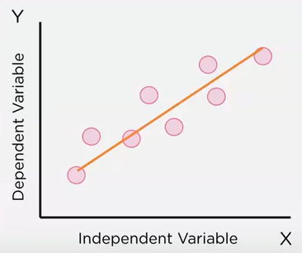
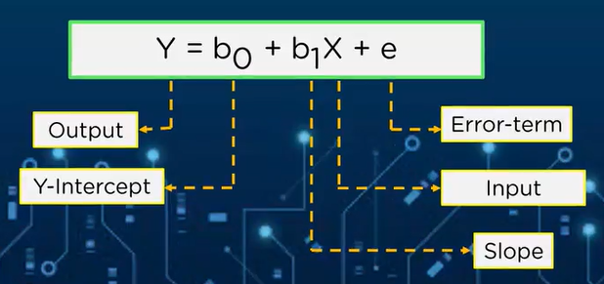
Linear regression - discussion
The equation which can be used to fit a line is the equation of straight line.
This equation gives the output variable based on the input variable and inclination of the line.

Slide 11
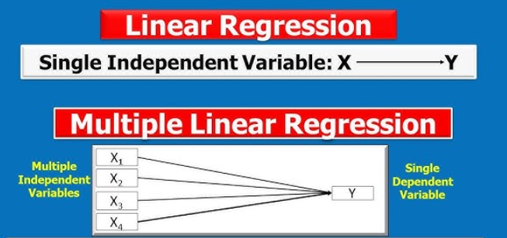
Simple Linear Regression VS Multiple Linear Regression

Slide 12
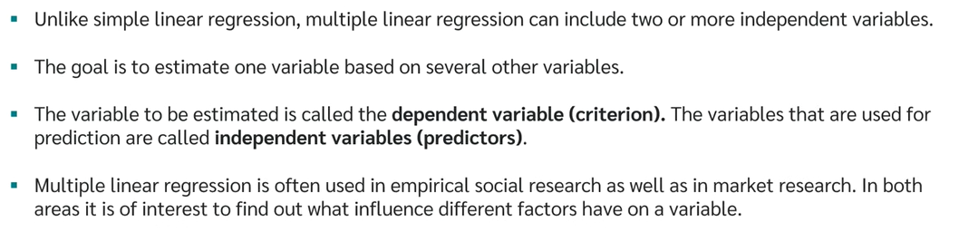
Multiple Linear regression

Slide 13
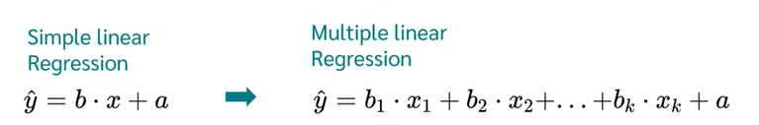
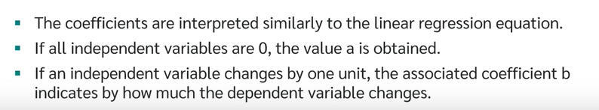
Multiple Linear regression

Slide 14
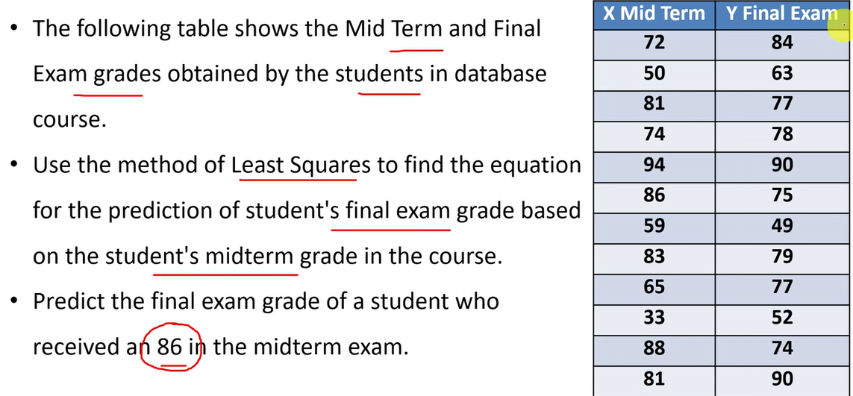
Linear regression – example problem

Slide 15
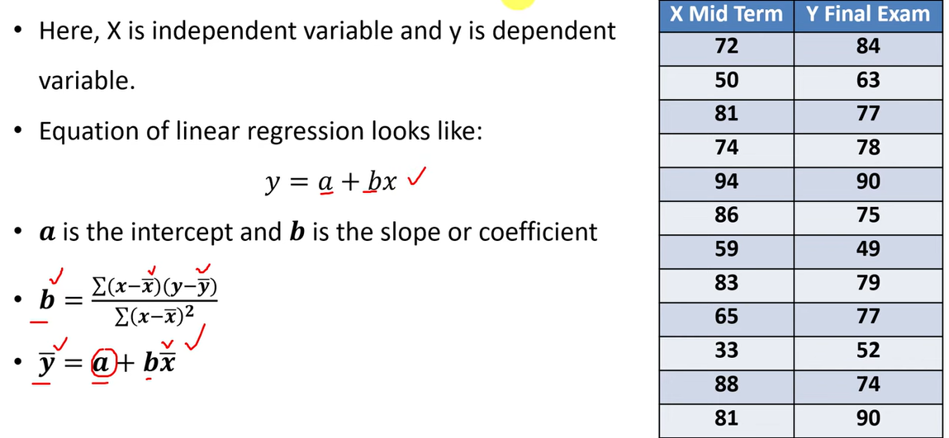
Linear regression – example problem

Slide 16
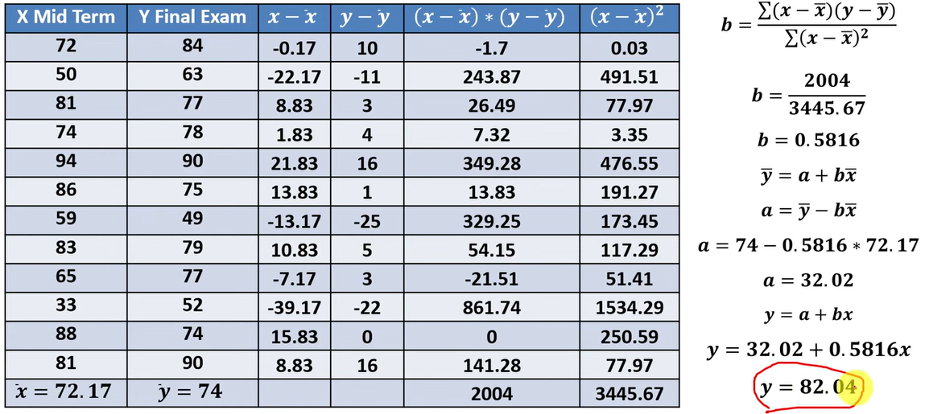
Linear regression – example problem

Slide 17
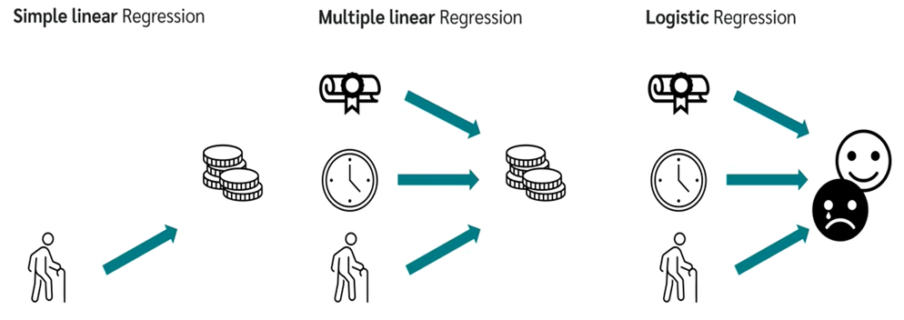
Forms of regression analysis

Slide 18
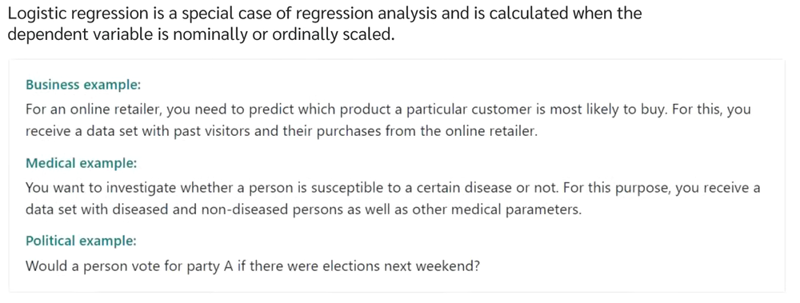
Logistic regression

Slide 19
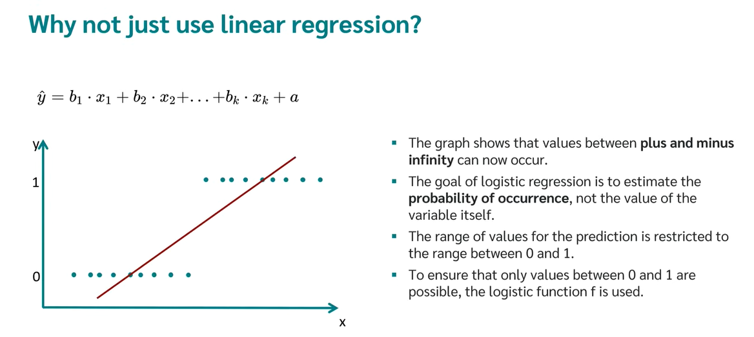

Slide 20
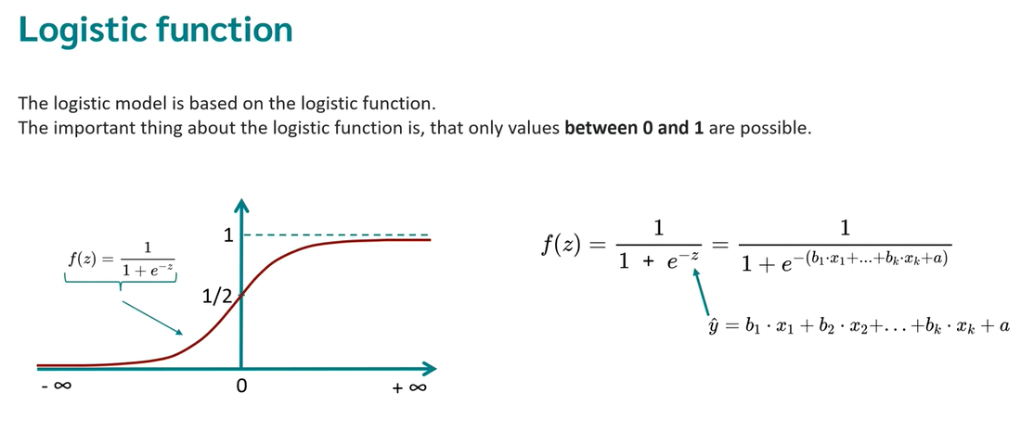

Slide 21
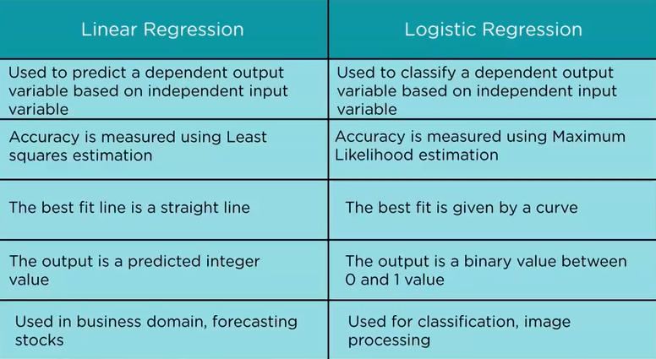
Linear Regression VS Logistic Regression

